Slide 1
Moulded by the darkness: Grokking the TypeScript type system
Ivan Towlson
Microsoft

Slide 2
JavaScript The universal runtime

Slide 3
JavaScript The language for the universal runtime

Slide 4
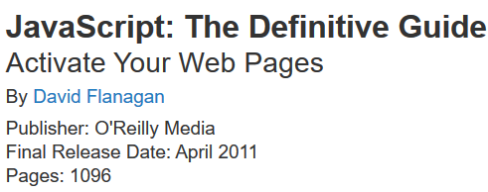
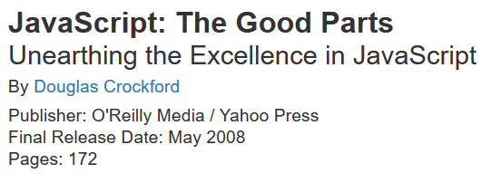
JavaScript The universally hated language for the universal runtime
Includes the appendix about the bad parts

Slide 5
JavaScript The assembly language for the universal runtime

Slide 6
ClojureScript
php.js
Script#
Fable
Java GWT
Scala.js
CoffeeScript
PureScript
JavaScript
Browser
Node.js
etc.

Slide 7
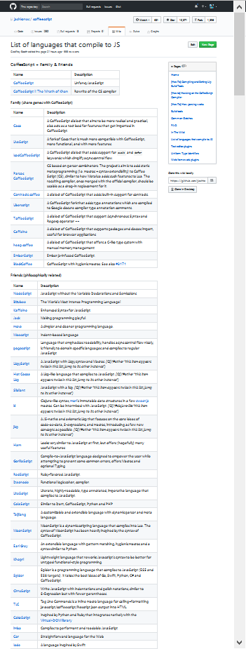
https://github.com/jashkenas/coffeescript/wiki/list-of-languages-that-compile-to-js
Screenshot at 30%

Slide 8
JavaScript The language for the universal runtime

Slide 9
TypeScript The language for the universal runtime

Slide 10
TypeScript The language for the universal runtime …with benefits

Slide 11
What do we talk about when we talk about types?

Slide 12
Thanks!
Ivan Towlson
Microsoft
https://github.com/itowlson/typed-darkness
http://twitter.com/ppog_penguin
http://hestia.typepad.com/flatlander
itowlson@microsoft.com
ivan@hestia.cc

